Slide 1

UNIVERSITY MEETING SCHEDULER
Afaq Bukhari 18F-0127
M Jamshaid 17F-8217
Zain Raza 18F-0200
Supervisor
Ms. Anmol Bilal
Co-Supervisor
Dr. Umar Aftab

Slide 2
Introduction
UMS is a web and android-based application to provide automated assistance in scheduling meetings among the various offices of FAST NUCES including the students from all departments and degree programs.
The system will provide an easy-to-use platform to schedule and access the availability of its members.
A student will be able to schedule a meeting with the teacher through the app or web portal and the teacher would be able to accept or reject the request.
If the request is accepted then with the help of certain algorithms meeting will be scheduled automatically in a slot in which the teacher and as well the student will be free.
If the first slot found by the system is already occupied, it will look for the second-best slot.

Slide 3
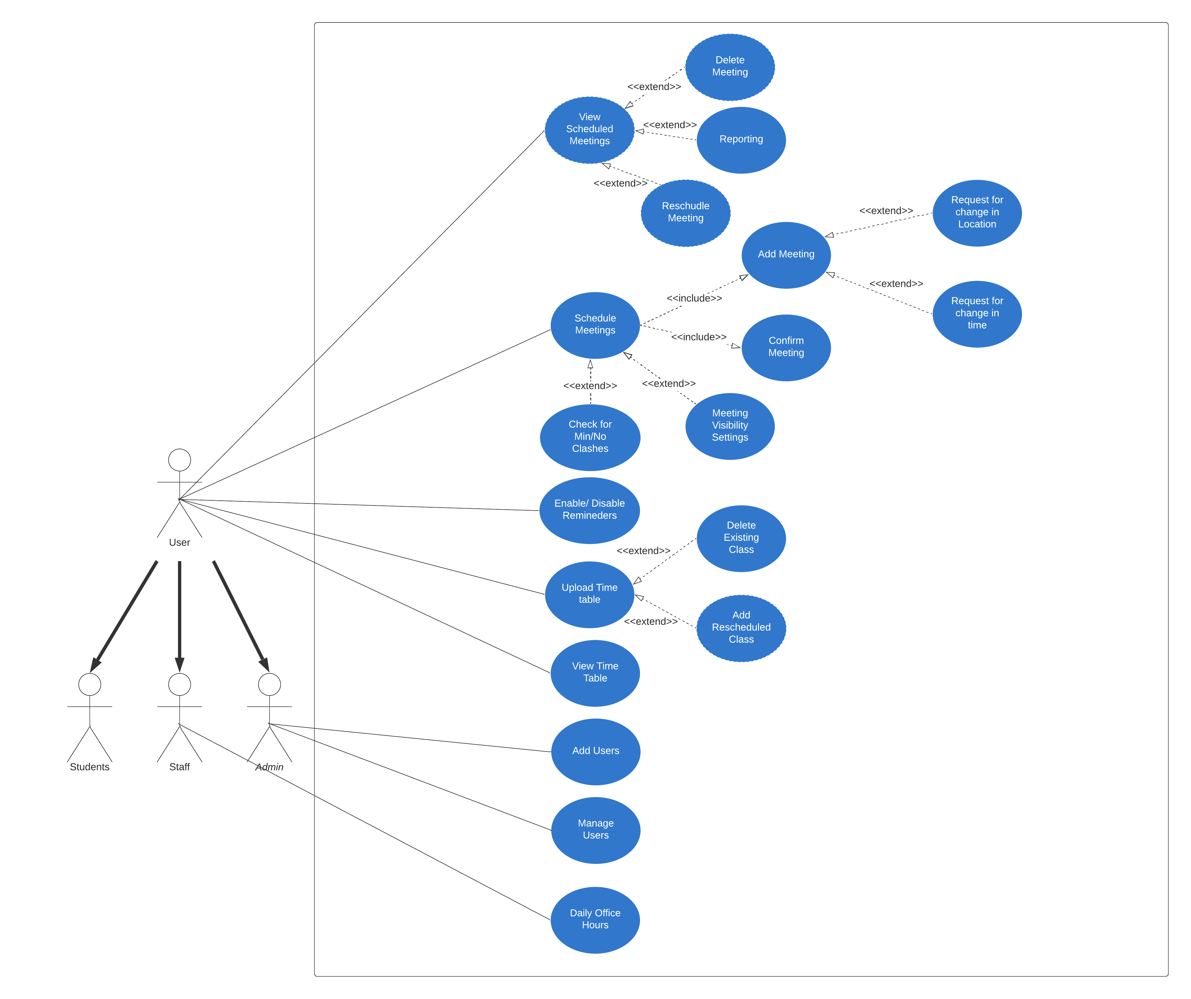
Use Case Diagram

Slide 4
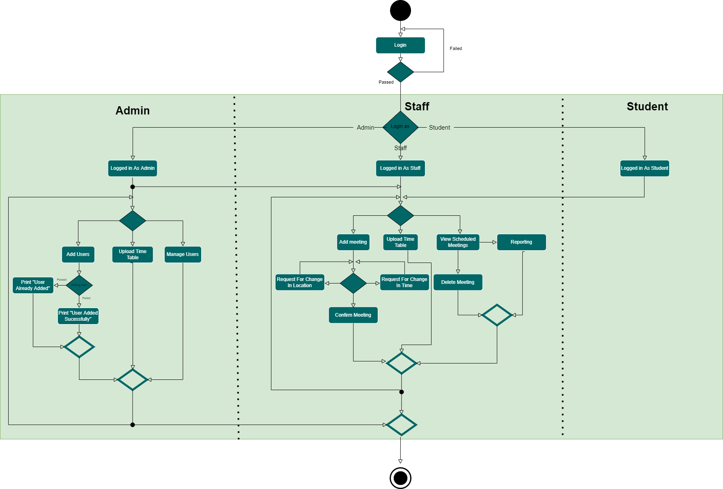
Activity Diagram

Slide 5
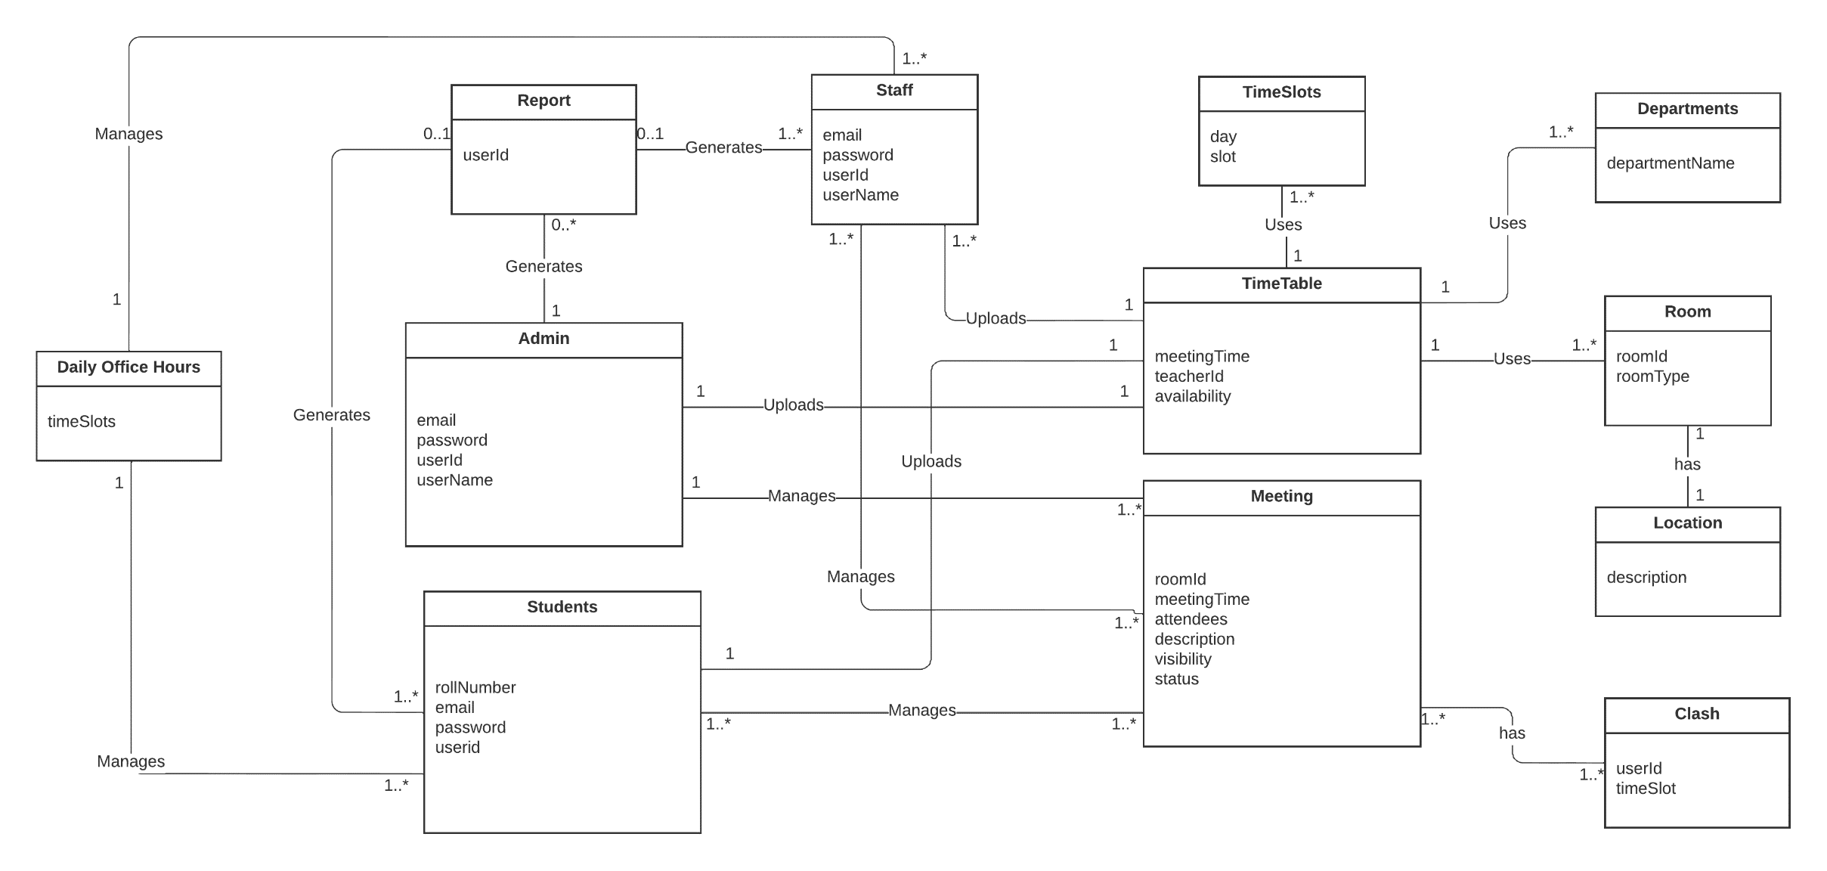
Domain Model

Slide 6
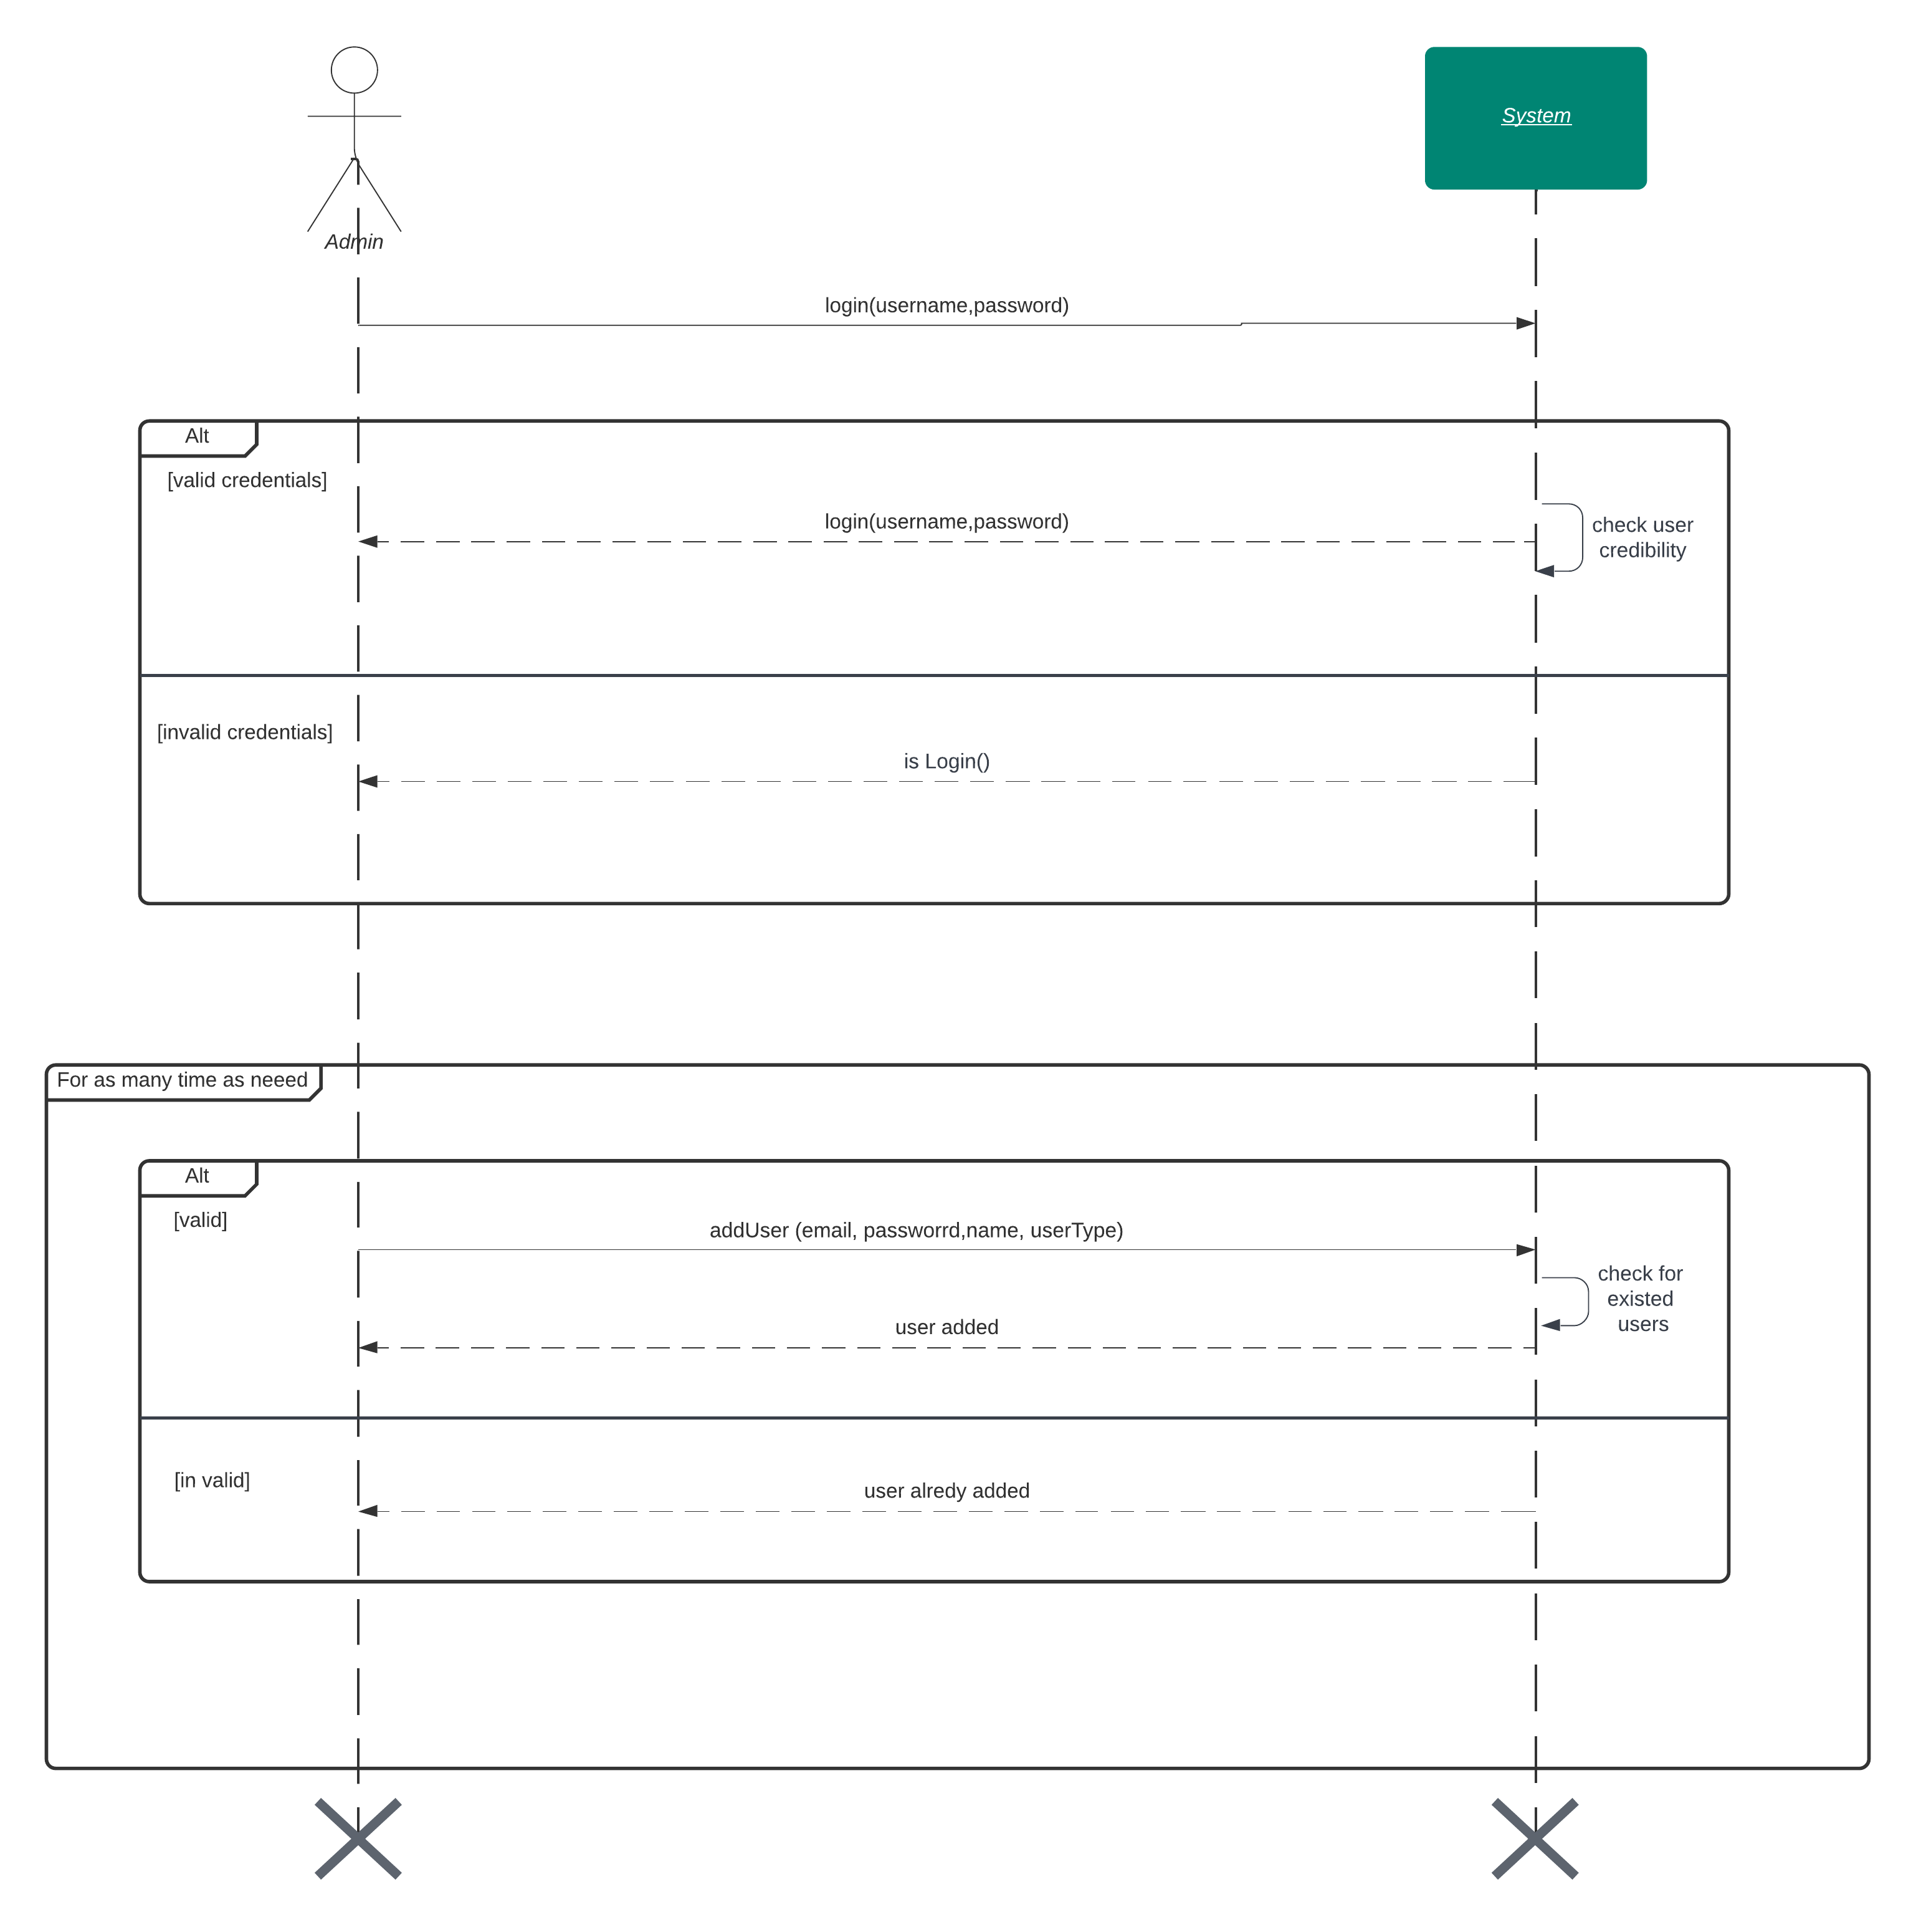
System Sequence Diagram
Add user System Sequence Diagram

Slide 7
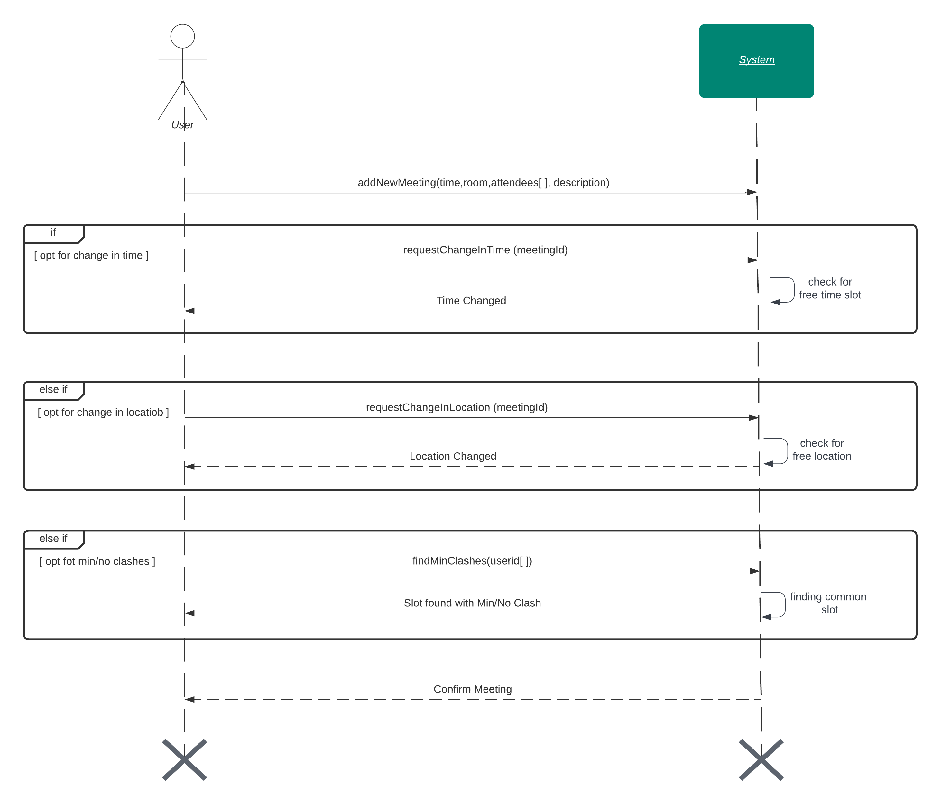
System Sequence Diagram
Adjust Timetable – System Sequence Diagram

Slide 8

System Sequence Diagram
Manage User– System Sequence Diagram

Slide 9
Sequence Diagram

Slide 10
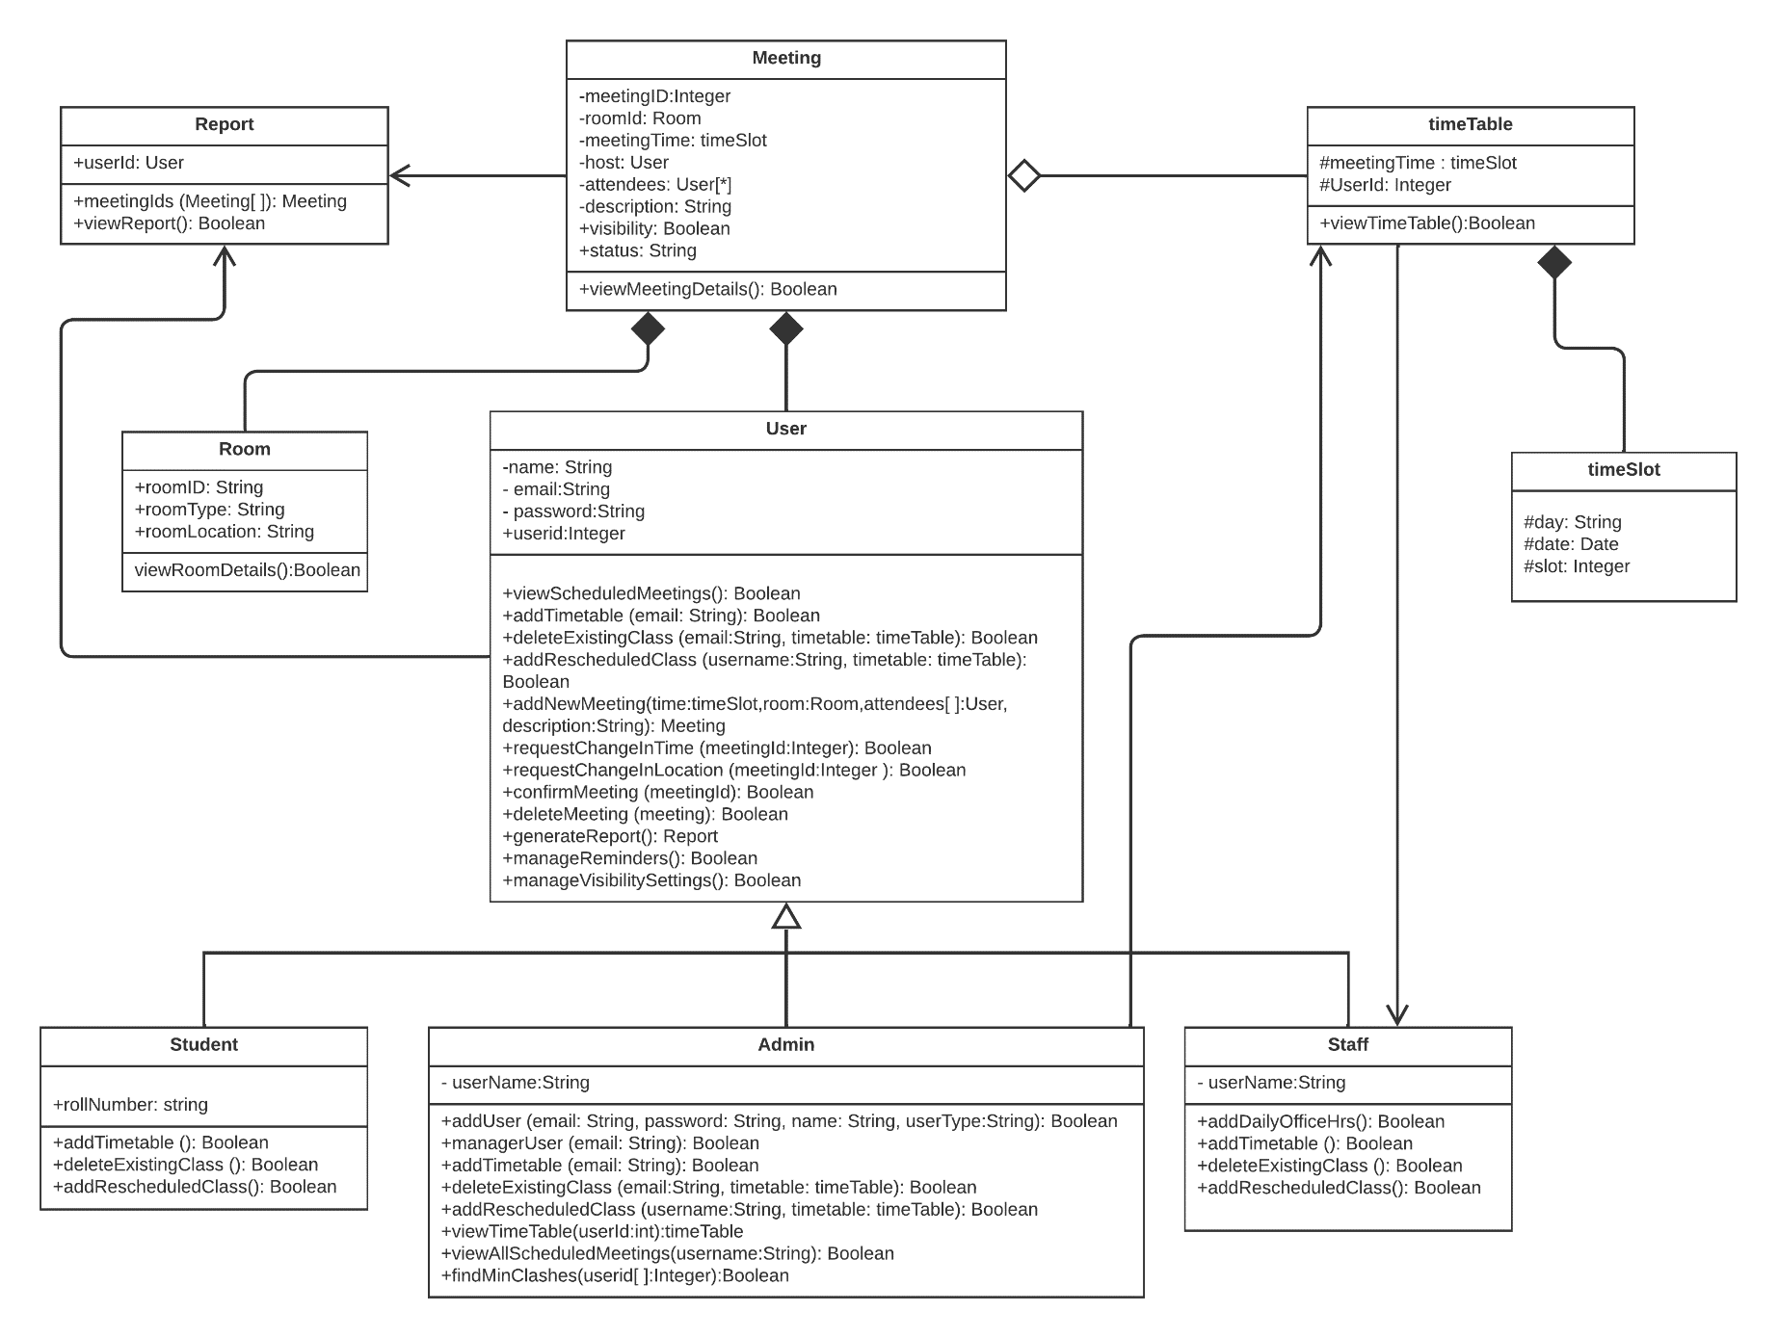
Class Diagram

Slide 11
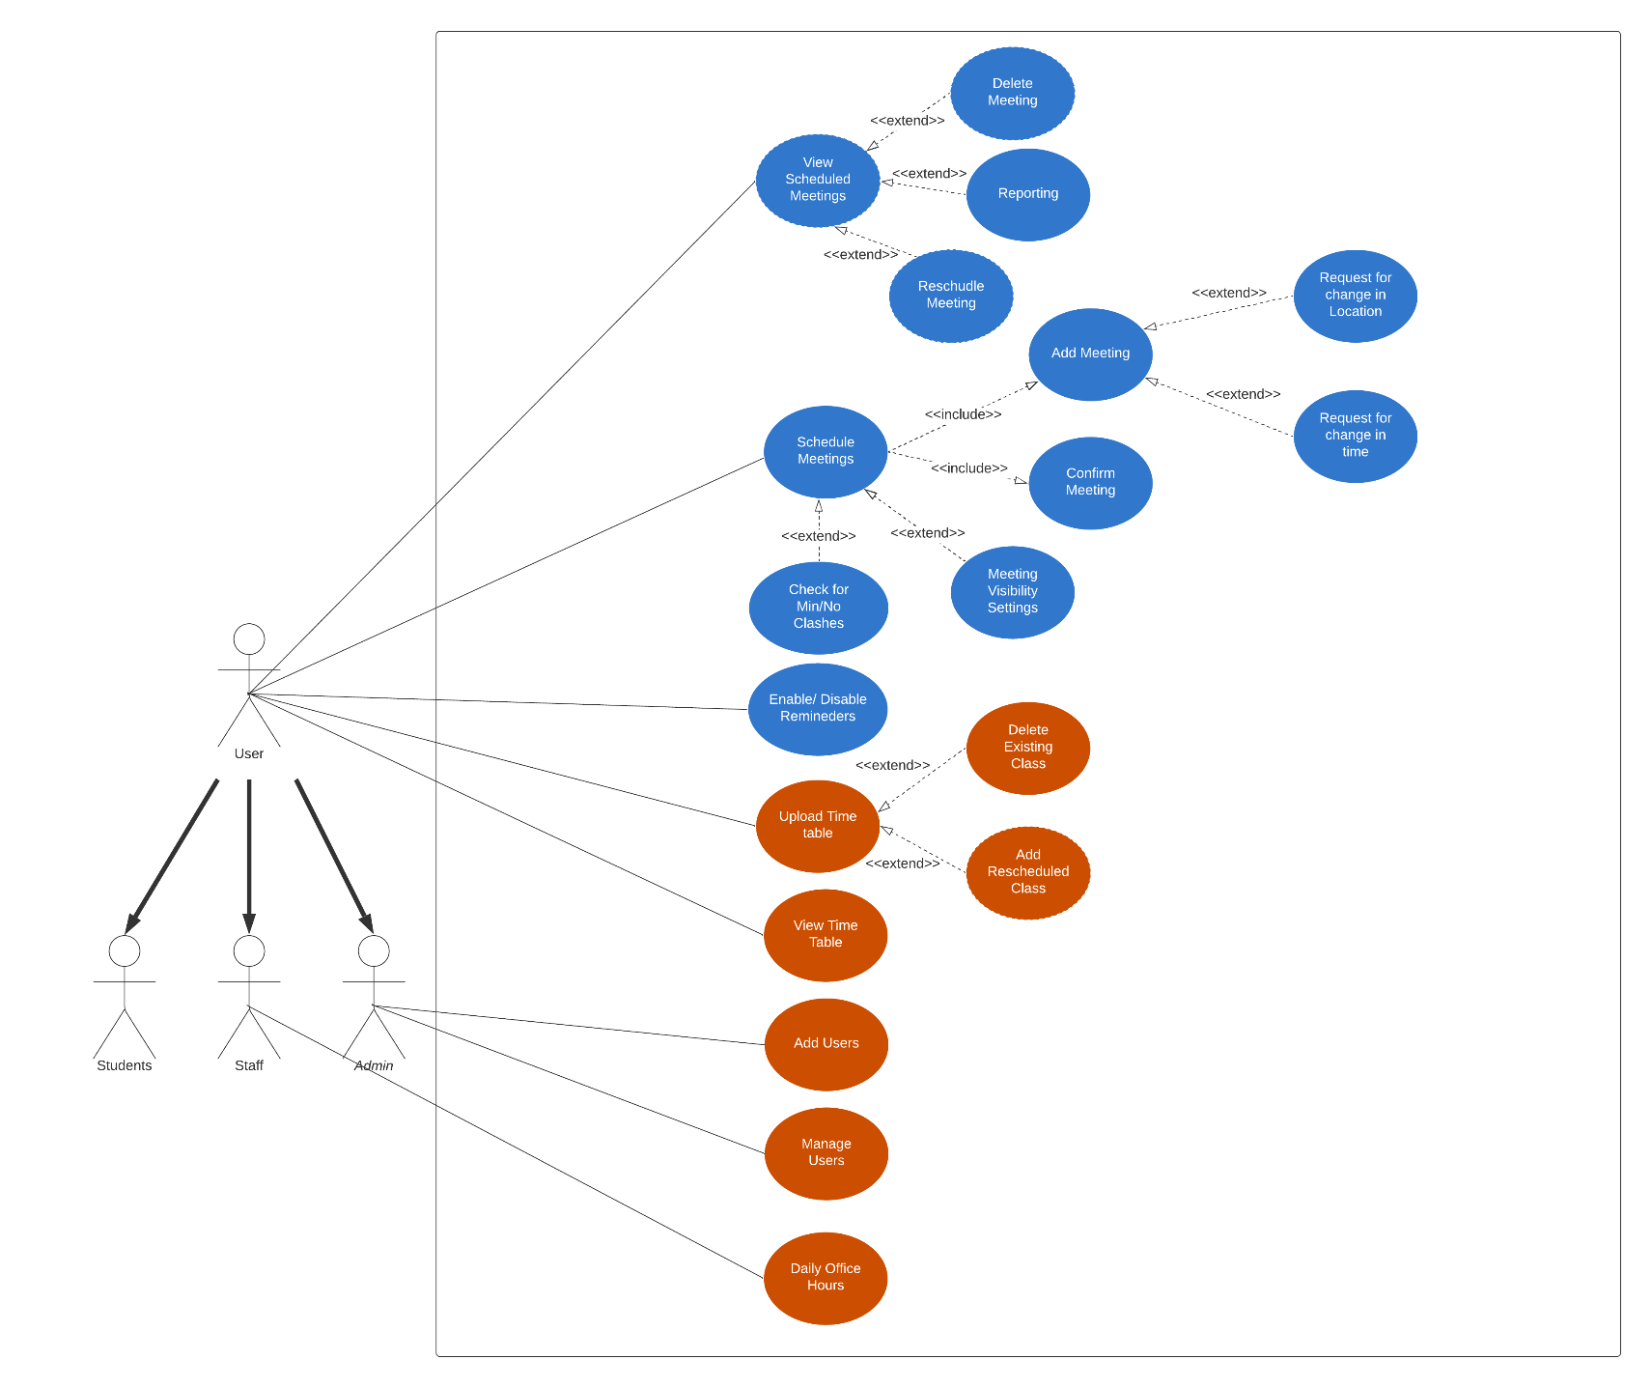
Highlighted Use Case

Slide 12
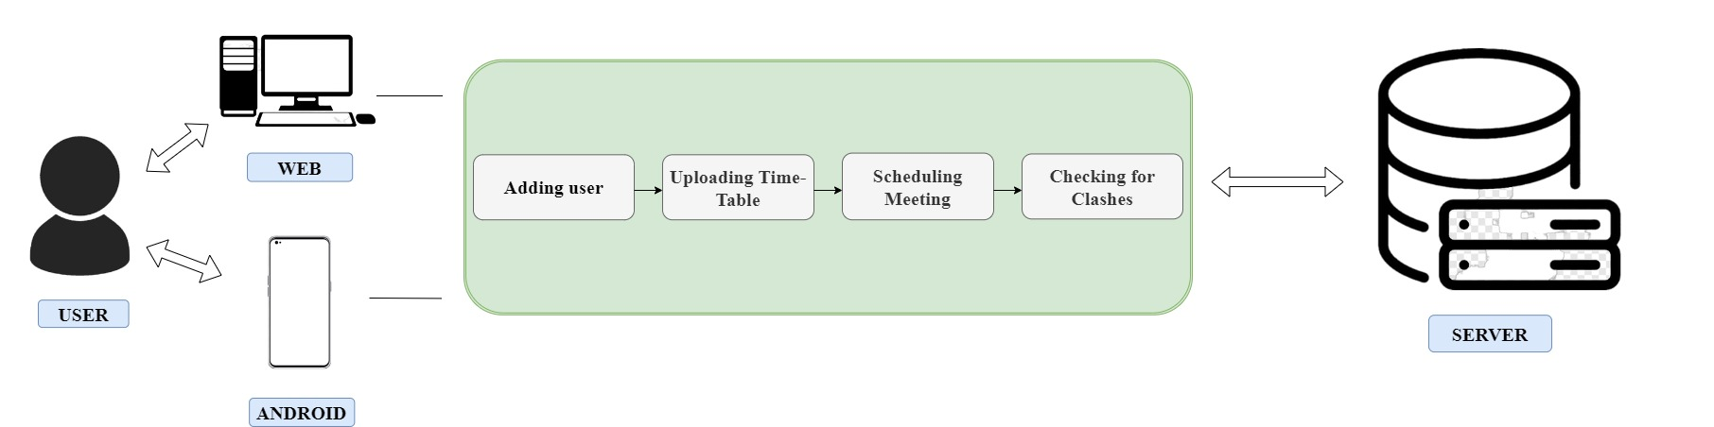
Architecture Diagram

Slide 13
Thank You!

